Slide 1
Binary Addition

Slide 2
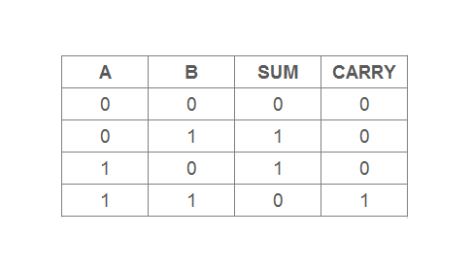

Slide 3
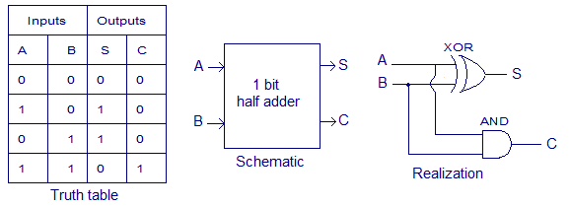
Half Adder

Slide 4
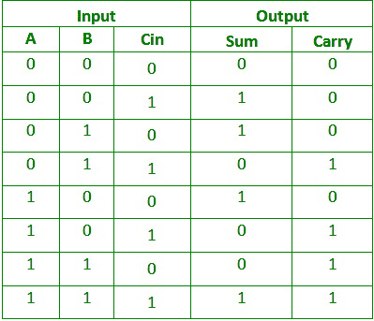
Full Adder Truth Table

Slide 5
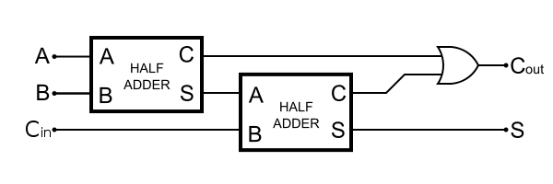
Full Adder

Slide 6
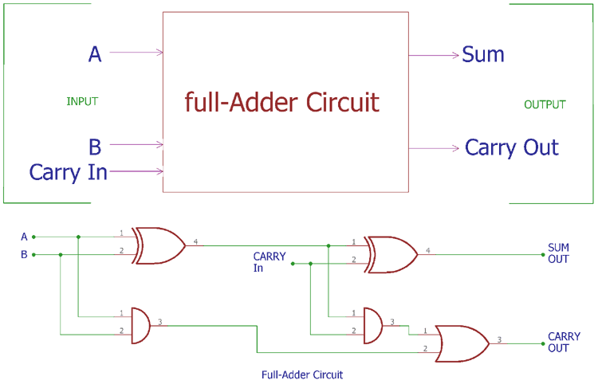
Full Adder Circuit

Slide 7
External Circuitry Interface
An Arduino program sets the A, B and Cin levels (HIGH or LOW), which are inputs to the external circuitry. The circuitry produces the Sum and Cout levels, which are connected to Arduino input pins.

